Slide 1

Image Processing in C
Group –6 Members:
Arnab Nath(2021CSB054)
Sk Fardeen Hossain(2021CSB023)
Avishek Rana(2021CSB056)
Ankita Das(2021CSB055)
Sujit Pradipkumar Jaiswal(2021CSB086)
Project Advisor:
Prof. Dr. Sekhar mandal

Slide 2
Index
Introduction to Image Processing
Concept of Gray-Scale Images
Handling with PGM files in C
Implementing a read and write subroutine in C
Concept of kernels and filters in image processing
Developing an Average Filter Kernel in C
Developing a Median Filter Kernel in C
References

Slide 3
Introduction to Image Processing
Image processing in general refers to the manipulation of digital/analog images through some algorithms. In our course of work we are working with digital images, thus doing digital image processing which has advantages over analog image processing in terms of wide range of algorithms and the ability to process out the noise and distortions during the build-up of the image.
Images are formatted in different file formats like TIFF, BMP, PGM, PNG, JPG, etc. In our course work we will be studying and dealing with PGM images.
Image processing requires prerequisite knowledge regarding handling with the given file format in the given language for development and basic programming skills.
Our development language will be C, but one can use any other language to do image processing.
At the end of the course work we will be able to appreciate the need for image processing.

Slide 4
Concept of Gray-Scale Images
Gray-Scale images are those image where the value of each pixel is a single sample representing the amount of intensity of light it contains, thereby giving various shades of gray. The contrast ranges from black at the weakest intensity to white at the strongest.
The minimum intensity value of each pixel is 0(black) and the maximum intensity value depends on the number of bits each pixel is composed of(if it is n bits the maximum value is 2^n-1). For our course work we will be dealing with 8 bit images so the maximum value of each pixel is 255(100% white). Thus we are expressing information in 256 intensity levels for each pixels.
The concept of gray-scale images can be expanded to get coloured images in RGB format where each pixel contains information regarding the intensity value in Channel-Red, Channel-Green and Channel-Blue.
Let us now delve deep into PGM file formatting and handling PGM files in C.

Slide 5
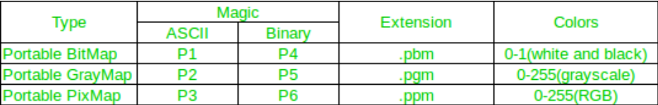
Handling with PGM Files
PGM stands for Portable Gray Map. Saving a 2D array in C as images in PNG, JPG or other formats would need a lot of effort to encode the data in the specified format before writing to a file.
Each file starts with a two-byte magic number (in ASCII) that identifies the type of file it is (PBM, PGM, and PPM) and its encoding (ASCII or binary). The magic number is a capital P followed by a single-digit number.
The ASCII formats allow for human readability and easy transfer to other platforms; the binary formats are more efficient in file size but may have native byte-order issues. In the binary formats, PGM uses 8 bits per pixel.
We will be using GIMP as our image viewer for PGM files.

Slide 6
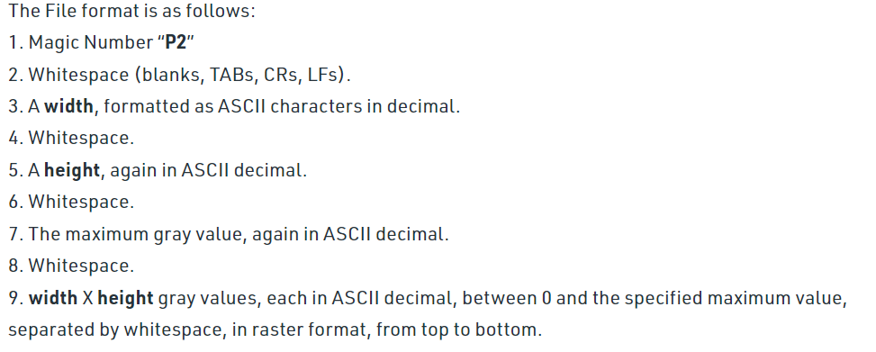
Contents in PGM File

Slide 7
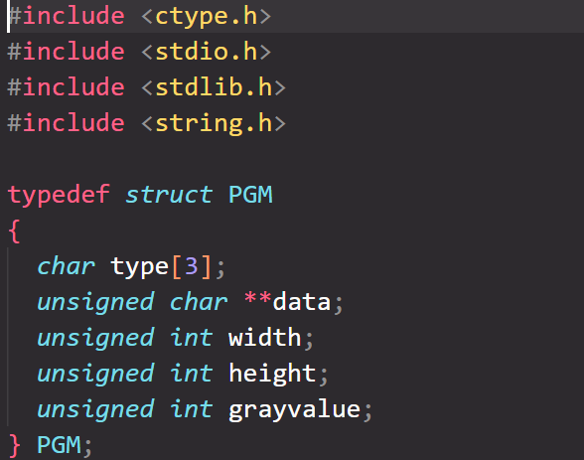
Implementing a read and write subroutine in C
1. Structure for handling the PGM file
Storing the type of file("Px\n").
2D array storing the intensity value of each pixel.
Storing width of the file in pixels.
Storing height of the file in pixels.
Storing the maximum grayscale value of all the pixels in the file.

Slide 8
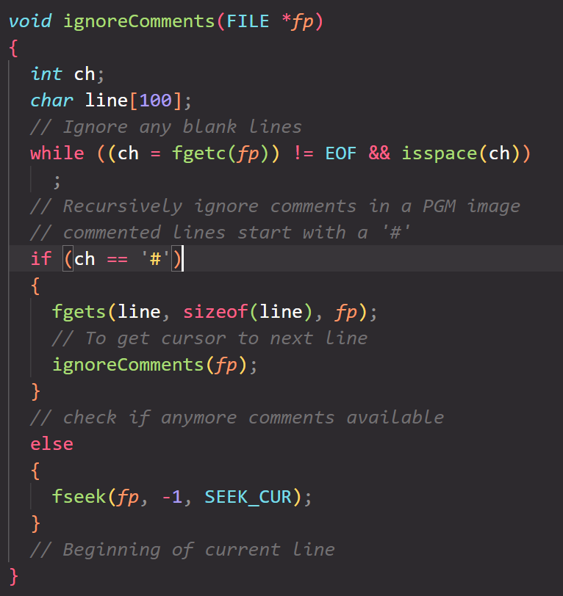
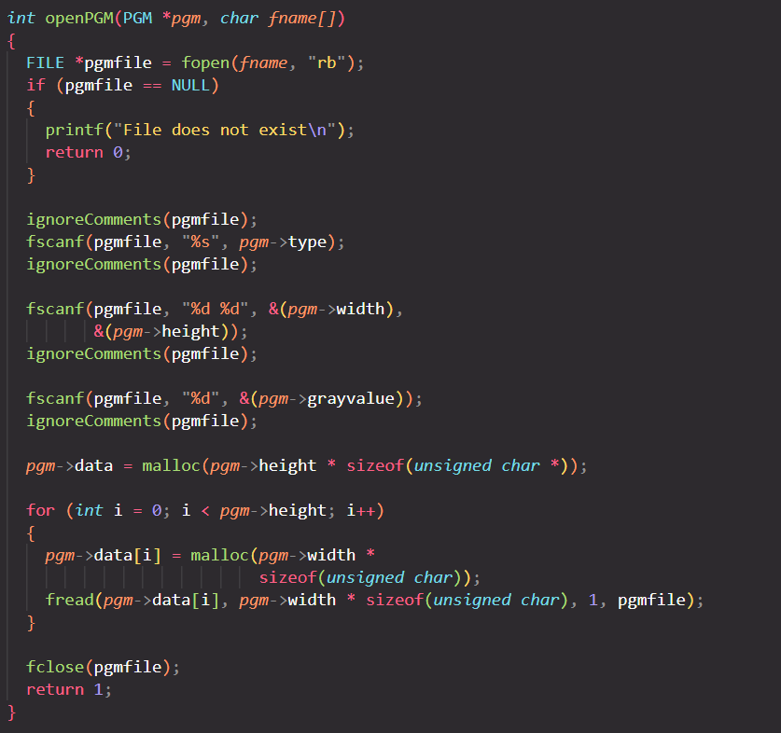
2. Function for ignoring comments in the file
3. Function for reading the PGM file

Slide 9
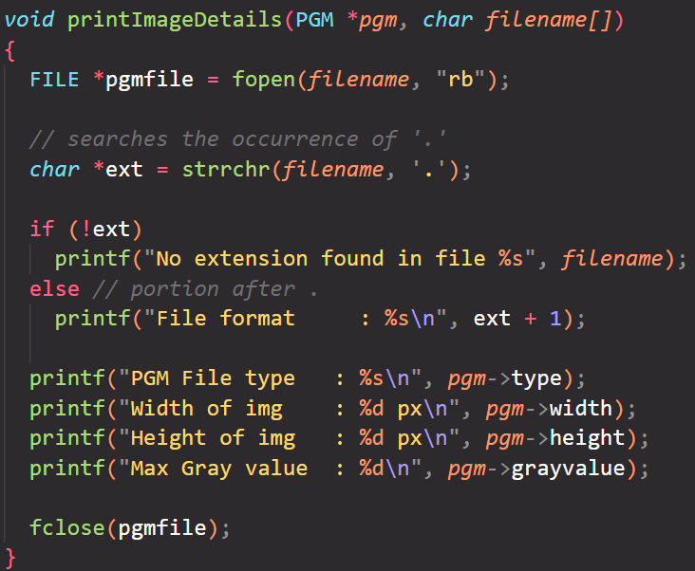
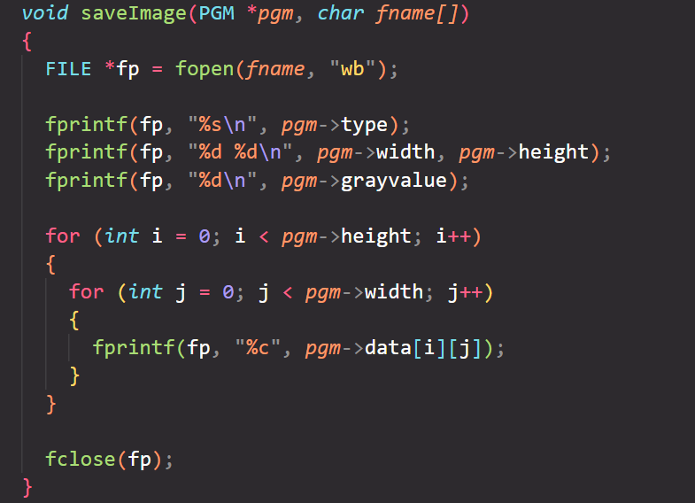
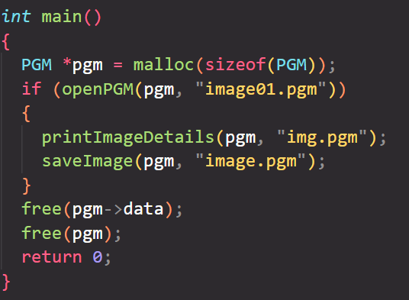
4. Function for writing contents into PGM File
5. Printing Image Details of the given File.
6. Main Function

Slide 10
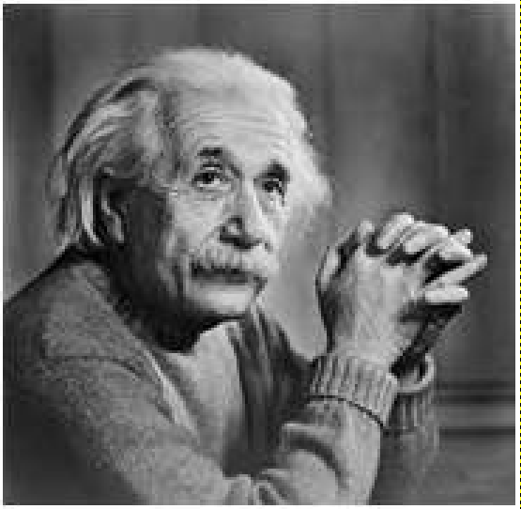
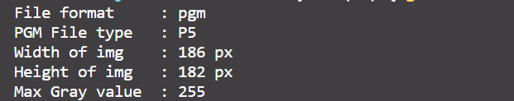
Testcase 01:
Input File
Output File
Image Details:

Slide 11
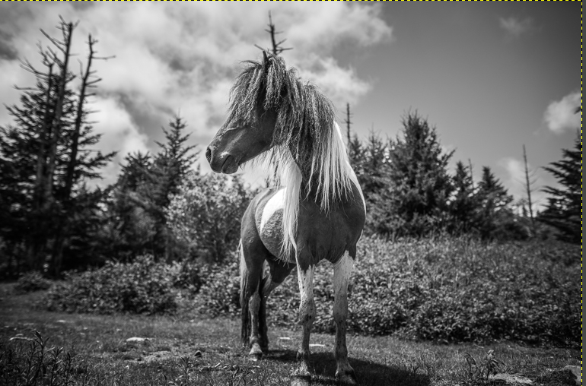
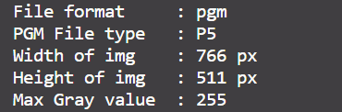
Testcase 02:
Input File
Output File
Image Details:

Slide 12
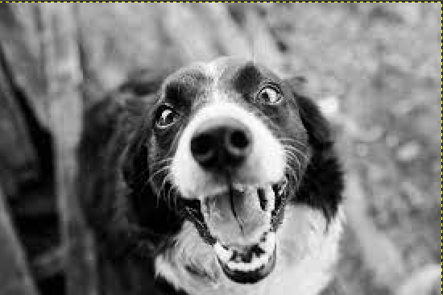
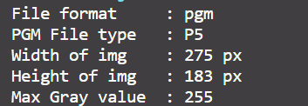
Testcase 03:
Input File
Output File
Image Details:

Slide 13
Concept of kernels and filters in image processing
In image processing, a kernel, convolution matrix, or mask is a small matrix used for blurring, sharpening, embossing, edge detection, and more. This is accomplished by doing a convolution between the kernel and an image.

Slide 14
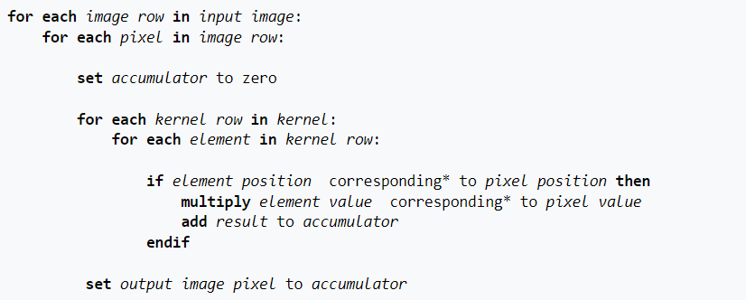
Any pixel in the output image which would require values from beyond the edge is skipped and the convolution is done only for the existing neighbouring pixels for the current pixel.
We have implemented the following brute force algorithm for filtering without any optimisation:
In the course-work, we have implemented the average kernel and median kernel filter for various types of images.

Slide 15
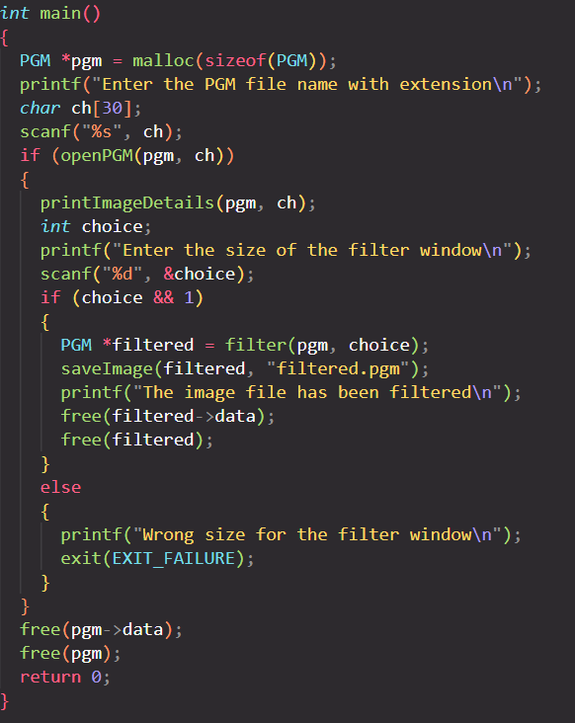
Developing an Average Filter Kernel in C
1. Main Function
We have maintained the same read and write subroutines as mentioned in the previous code snippets, and have added a new function named filter() which accepts the PGM structure pointer and the size of filter window; and also tweaked the main function to some extent.

Slide 16
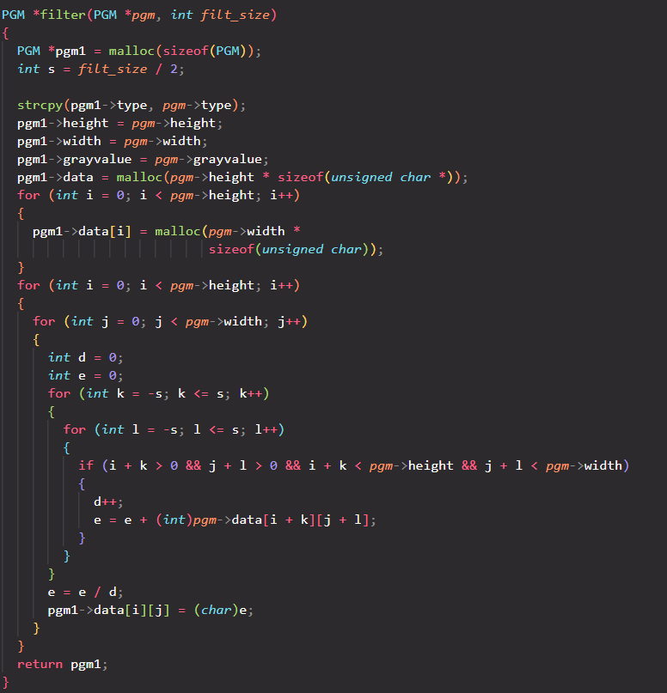
Filter Function

Slide 17
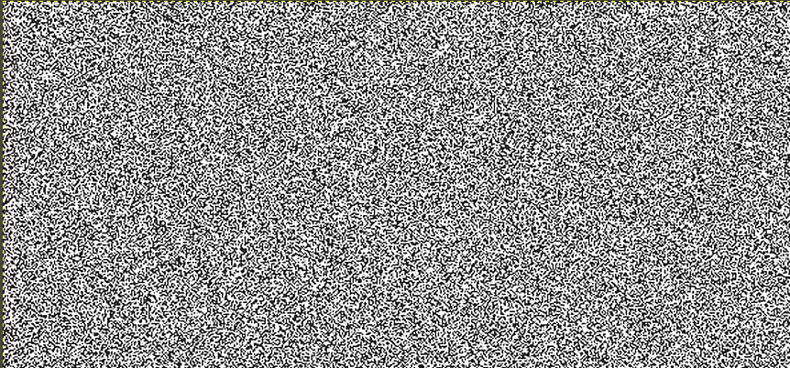
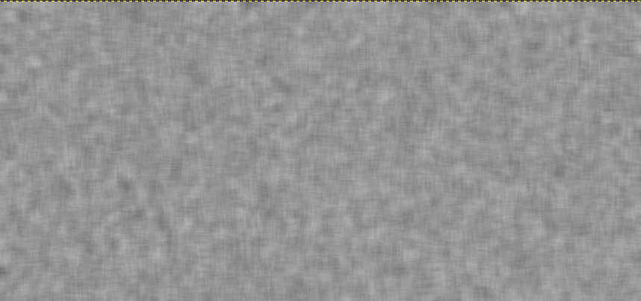
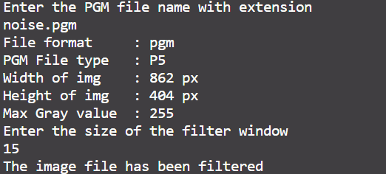
Testcase 01:
Input File
Output File
Image Details:

Slide 18
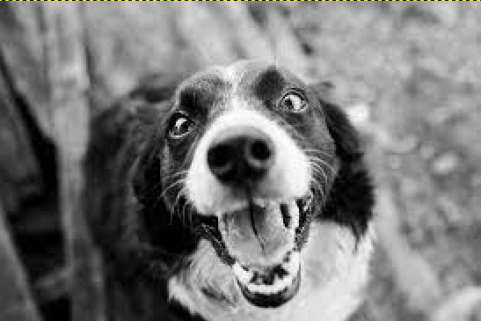
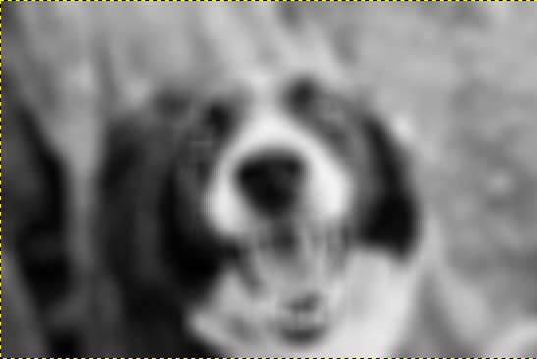
Testcase 02:
Input File
Output File
Image Details:

Slide 19
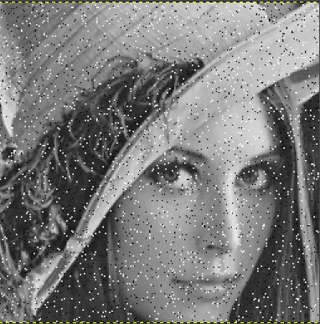
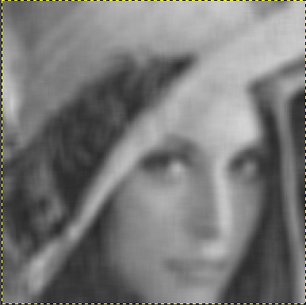
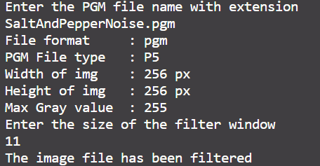
Testcase 03:
Input File
Output File
Image Details:

Slide 20
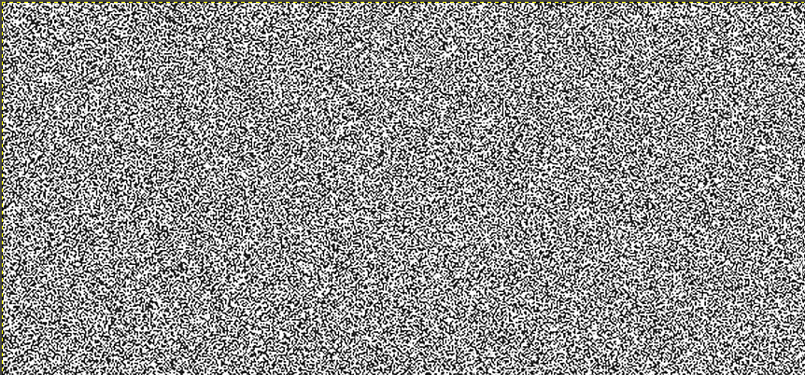
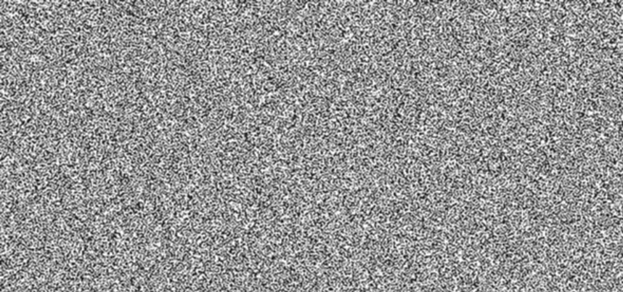
3x3 Filter kernel:
Input File
Output File

Slide 21
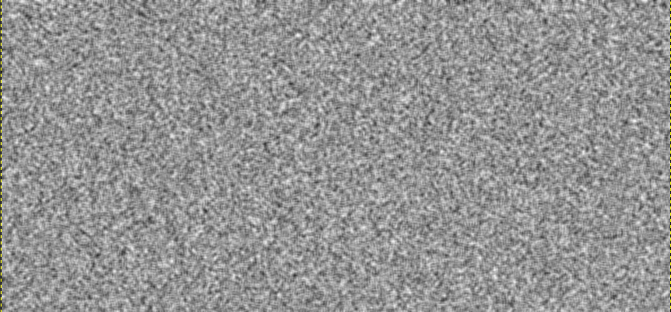
5x5 Filter kernel:
Input File
Output File

Slide 22
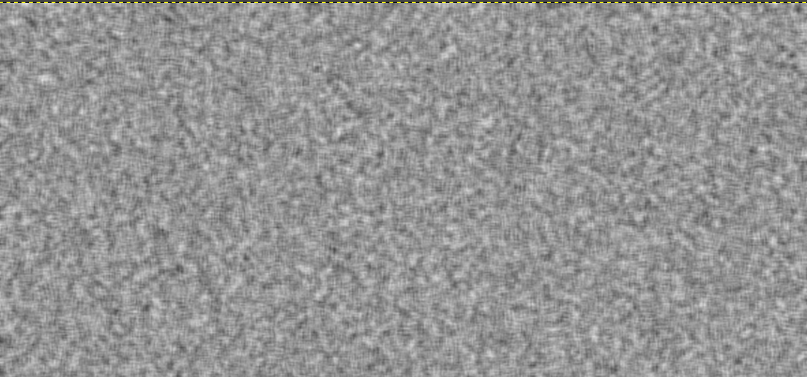
7x7 Filter kernel:
Input File
Output File
The Blurring effect increases with increase in size of filter kernel

Slide 23
Developing a Median Filter Kernel in C
1. Main Function
We have maintained the same read and write subroutines as mentioned in the previous code snippets, and have added a new function named filter() which accepts the PGM structure pointer and the size of filter window; and also tweaked the main function to some extent.

Slide 24
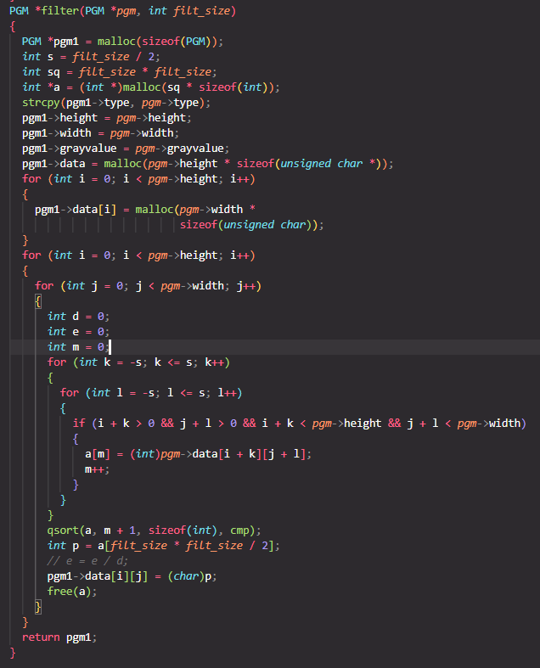
Filter Function
Filter Function

Slide 25
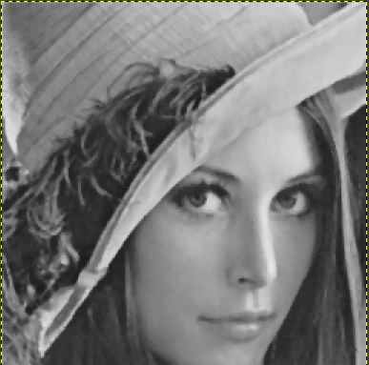
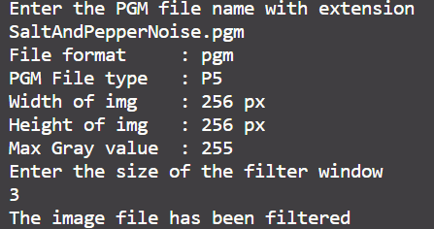
Testcase 01:
Input File
Output File
Image Details:

Slide 26
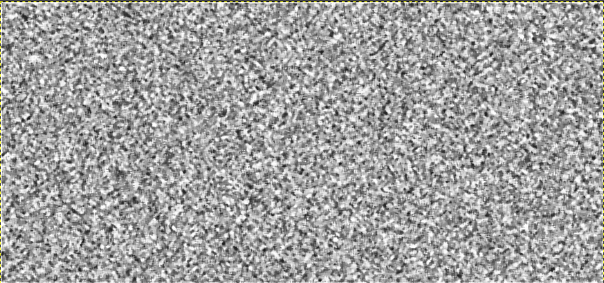
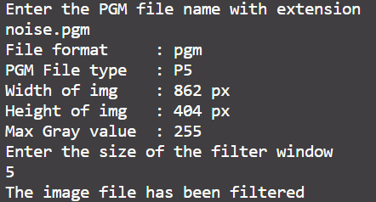
Testcase 02:
Input File
Output File
Image Details:

Slide 27
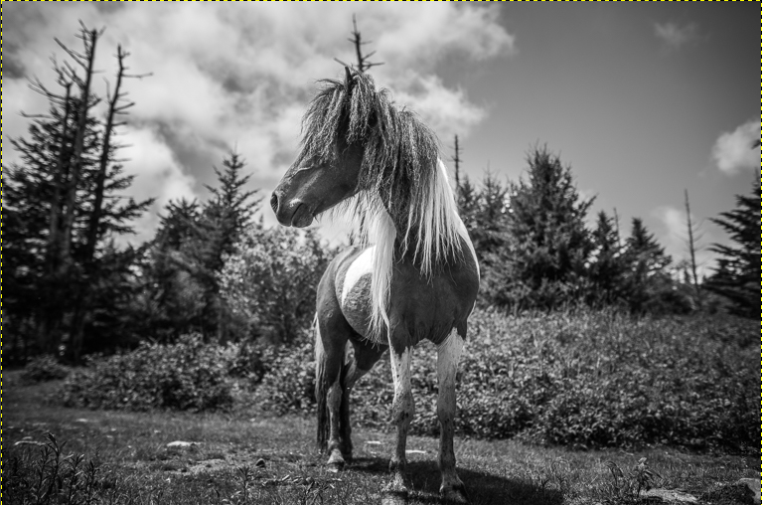
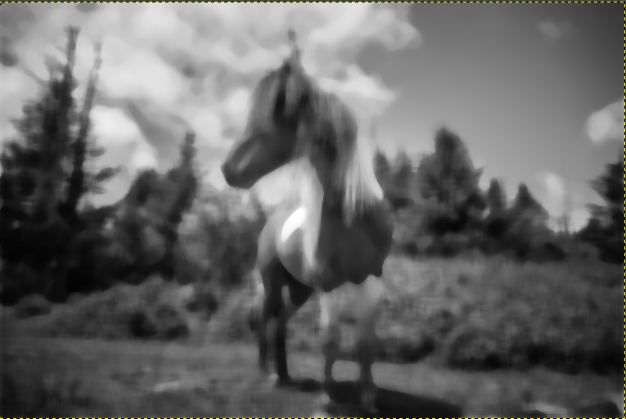
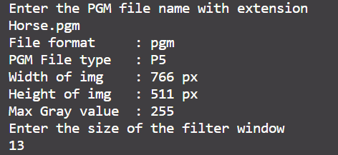
Testcase 03:
Input File
Output File
Image Details:

Slide 28
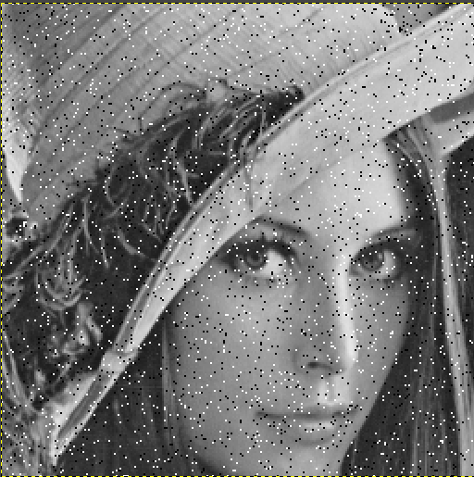
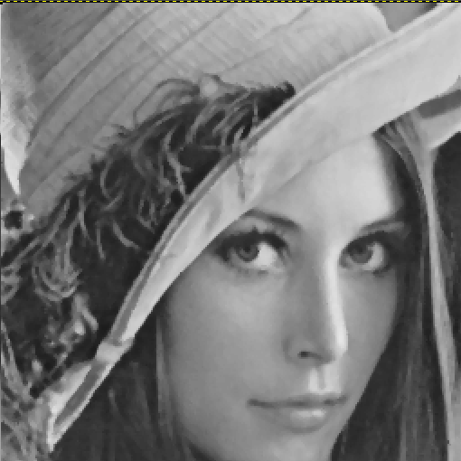
3x3 Filter kernel:
Input File
Output File

Slide 29
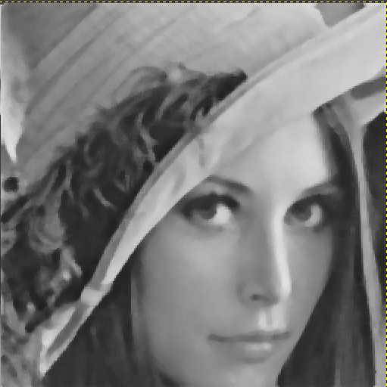
5x5 Filter kernel:
Input File
Output File

Slide 30
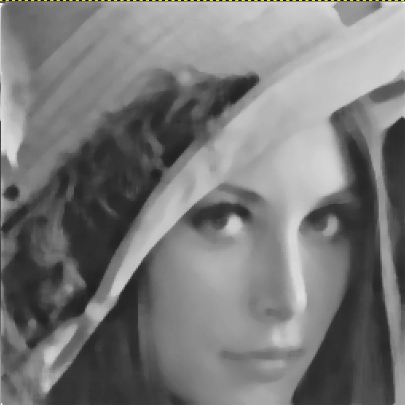
7x7 Filter kernel:
Input File
Output File
The image becomes smoother with increase in size of filter kernel

Slide 31
References:
Links:-
https://www.geeksforgeeks.org/c-program-to-write-an-image-in-pgm-format/
https://www.geeksforgeeks.org/how-to-read-a-pgmb-format-image-in-c/
https://en.wikipedia.org/wiki/Kernel_(image_processing)
https://setosa.io/ev/image-kernels/
Books:-
Image Processing in C by Dwayne Phillips

